Slide 1
Community Ecology
Today’s agenda:
Quiz,
Introductions,
Syllabus,
Paper Presentation assignment,
Project 1: Diversity Patterns,
Intro to Community Ecology,
Diversity Patterns

Slide 2
Introductions
Tell us:
Your name
Your research interests
Something interesting about yourself

Slide 3
Syllabus: basic stuff
Class Meeting Days: M, W
Class Meeting Time: 3:30 – 4:45 pm
Class Meeting Location: DAV 260
Instructor: Dr. Brian Maitner
Office Location: DAV 226 (but I’m usually in URL 106, because it’s warmer)
Office Hours: TBA - ?
Email: bmaitner@usf.edu

Slide 4
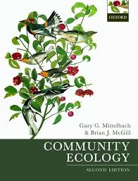
Syllabus: Course structure
Lectures and book - provide overview
Assignments - deeper dive into your own interests
Many small assignments = less stress
Graded Items Percent of Final Grade
Projects (4x) 40%
In-class quizzes 10%
Midterm 10%
Final 10%
Paper presentation assignments (2x) 10%
Conceptual Figure Assignment 5%
Network Assignment 5%
Group Presentation Assignment 5%
TBD Assignment 5%

Slide 5
Course Expectations
Participate! Ask questions. Share ideas, experiences, and knowledge!
Be respectful.

Slide 6
Recommendations
Read the syllabus
Read the book
Take notes on paper
Plan ahead

Slide 7
Questions so far?

Slide 8
Paper presentation assignment 1: Due Jan 29
Step 1: Find a paper on diversity patterns in your study system (or one you pick)
Step 2: Make 2 slides explaining the paper
Slide 1) graphics made by you that explain what was done in the study
Slide 2) what they found (should include results figure(s) from paper)
Step 3: Present the paper using those two slides (5 minute max)

Slide 9
Project 1: Diversity Patterns: Due Feb 7
Step 1: Pick a diversity pattern(s) relevant for your study system
Step 2: Find and read 10-20 relevant papers
Step 3: Write 2 pages about it (double spaced)
Introduction format, references don’t count against page limit
Potential things to include:
Description of patterns
Hypothesized mechanisms
Tests of mechanisms
Gaps in our knowledge

Slide 10
Questions so far?

Slide 11
What is Community Ecology?
“Community ecology is that branch of science focused squarely on understanding Earth’s biodiversity, including the generation, maintenance, and distribution of the diversity of life in space and time.” - Mittelbach and McGill

Slide 12
What is Community Ecology?
Molecule < Organelle < Cell < Tissue < Organ < Organism < Population < Community < Ecosystem < Biosphere

Slide 13
What is Community Ecology?
Science focused on multiple, co-occurring species.
Overlaps with other branches of ecology
Best not to stress over an exact definition

Slide 14
Why Community Ecology?
Community Ecology

Slide 15
Why Community Ecology?
Population dynamics
Community Ecology
Ecosystem Functioning

Slide 16
Why Community Ecology?
Evolution
Conservation
Population dynamics
Community Ecology
Ecosystem Functioning
Behavior

Slide 17
Why Community Ecology?
Evolution
Conservation
Human health
Agriculture
Population dynamics
Community Ecology
Ecosystem Functioning
Behavior
Business
Anthropology
Climate Models

Slide 18
Questions?

Slide 19
The history of community ecology

Slide 20
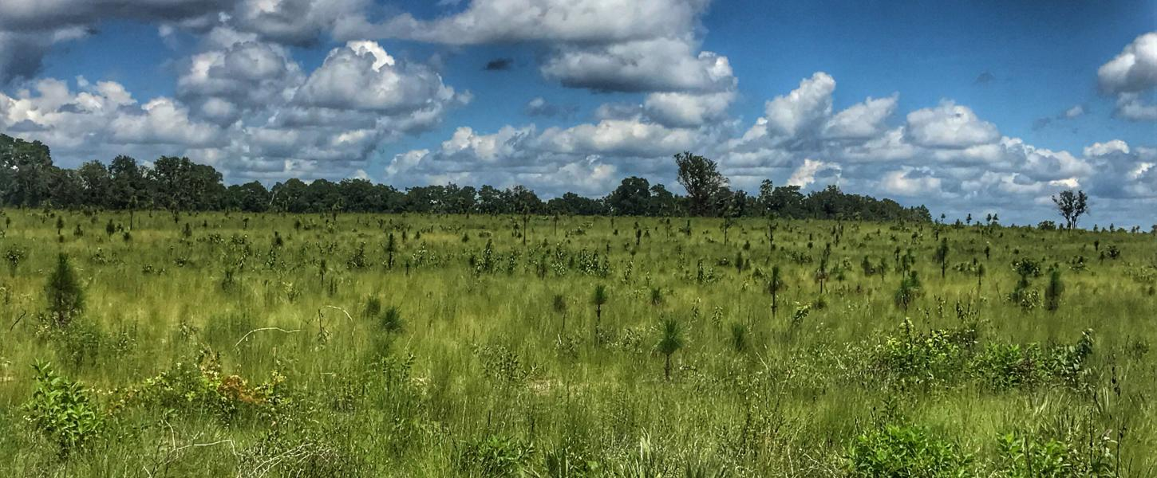
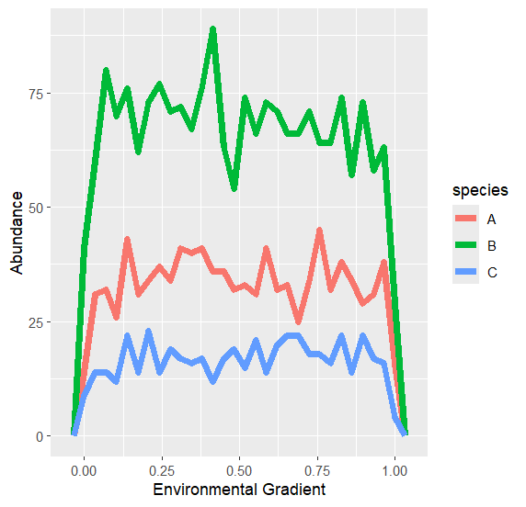
The history of community ecology
Started with plant ecologists in the early 1900’s
Thought there were fixed types of communities
Communities progressed towards a stable “climax community”
Image: Florida Department of Environmental Protection

Slide 21
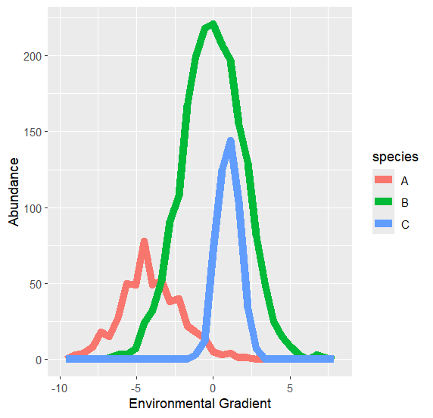
The history of community ecology
The idea of fixed types of communities has been abandoned
Communities as aggregations of individual species

Slide 22
Meanwhile, in the animal world…
Focus on demographic processes
Focus on interspecific interaction (competition, predation)

Slide 23

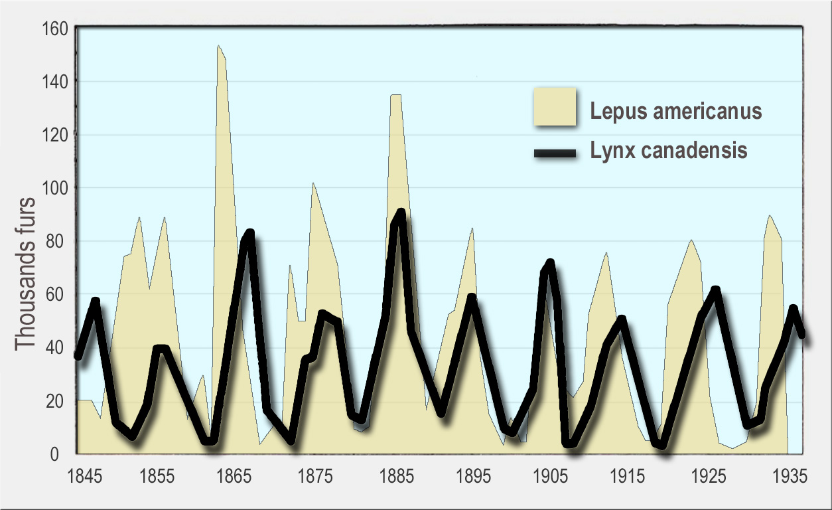
Meanwhile, in the animal world…
Focus on demographic processes
Focus on interspecific interaction (competition, predation)
Lotka-Volterra Model
By Lamiot - Own work based on Pilovsky et al. 2001 (p. 16, figure 1.13), CC BY-SA 4.0, https://commons.wikimedia.org/w/index.php?curid=45036611

Slide 24
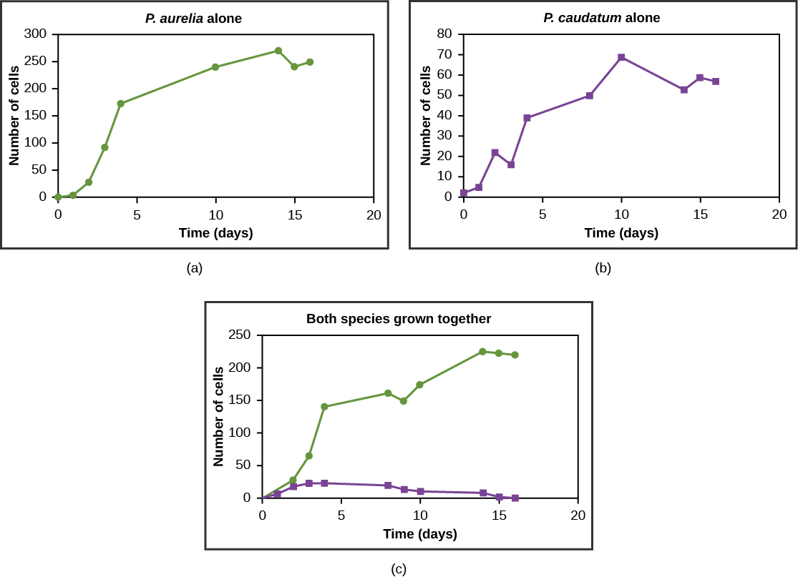
Meanwhile, in the animal world…
Mathematical equations let to predictions about coexistence
Tested in experimental systems
Competitive Exclusion Principle
CNX OpenStax - http://cnx.org/contents/GFy_h8cu@10.53:rZudN6XP@2/Introduction

Slide 25
Plants vs Animals
Plants - Focus on what lives where
Animals - Focus on interactions
These different focuses make sense!
Differences in generation times, predation vs herbivory

Slide 26
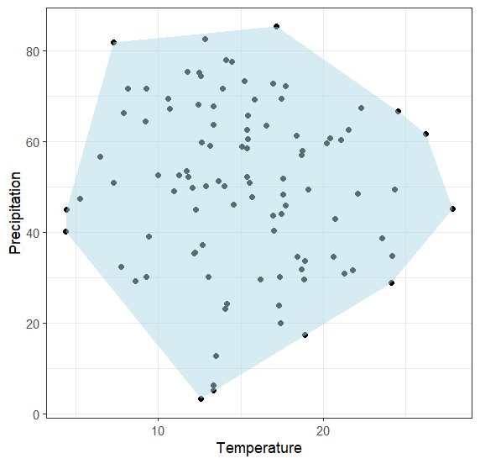
Niche Concept
Grinnellian (Abiotic) Niche: Environmental requirements

Slide 27
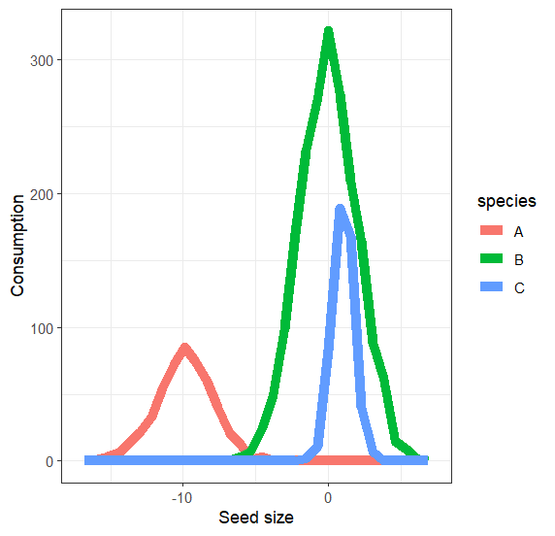
Niche Concept
Grinnellian (Abiotic) Niche: Environmental requirements
Eltonian (Biotic) Niche: Species’ interactions in a community

Slide 28
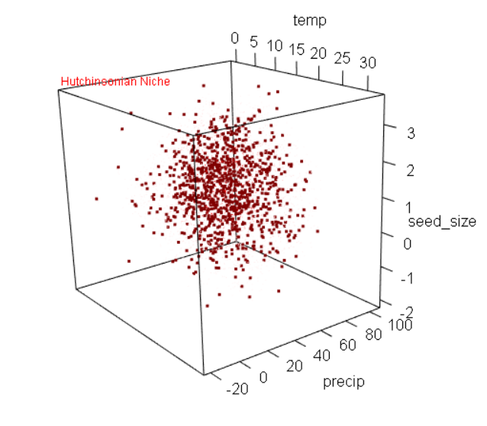
Niche Concept
Grinnellian (Abiotic) Niche: Environmental requirements
Eltonian (Biotic) Niche: Species’ interactions in a community
Hutchinsonian (n-dimensional) Niche: Environment + Interactions

Slide 29
Linking Niches to Competition
Competitive exclusion rule tied to niche overlap
Do niches have to be identical?

Slide 30
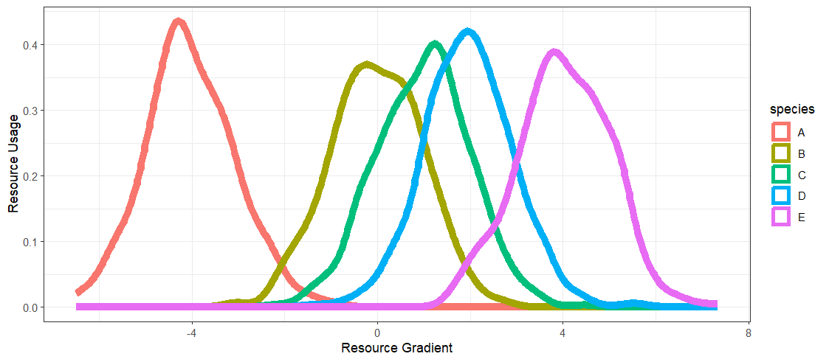
Limiting similarity
Improvement on the competitive exclusion principle
Notes:
Can project onto a whiteboard and color in the overlapping areas with dry erase marker

Slide 31
Reality Set In
Nature is complicated
Competition isn’t the only thing to consider
Importance of null models
Different, interacting processes operate at different scales

Slide 32
Community Ecology Today
Most of that “historical” stuff is still relevant
Embracing diversity of questions, mechanisms, approaches
Fancy stats and computational methods
New tools
Open Science / Open Data
Still lots of basic research and data to do

Slide 33
Next Class: Diversity Patterns

